Slide 1
Classification of Moving Crowd Based on Global Motion Feature
Aneek Roy ¹ Nimagna Biswas ¹ Sanjoy Kumar Saha ¹ Bhabatosh Chanda ²
¹ Department of Computer Science & Engineering,
Jadavpur University, Kolkata, India
² Electronics and Communication Sciences Unit,
Indian Statistical Institute, Kolkata, India
IEEE TENSYMP 2019
8 June 2019

Slide 2
Introduction to the problem statement
The problem of crowd structure classification has garnered the interest of computer vision researchers for a very long time.
The goal of our work is to classify a moving crowd as structured or unstructured crowd based on their motion pattern, which can act as a fundamental step towards crowd management and surveillance.

Slide 3
Past Work
Traditional work to solve this problem involved two approaches:
One involves a bottom-up approach whereby individual particles' motion are taken into account and the localized pixel-wise features are used to model the crowd behaviour.
Other is the top-down view of the model, whereby the global features of the crowd motion is tracked to model the entire crowd behaviour.

Slide 4
PAST WORK
Traditional computer vision algorithms as stated in [1] have failed to accurately model the crowd flow behaviour by object tracking as the individuality of the object is lost in the midst of the crowd flow.
These algorithms for modeling crowd flow work well for sparse and medium density distributions but for dense crowds the methods fail to achieve high accuracy.
Zhou et al. described the cumulative motion of a crowd through collectiveness property of the crowd, which indicates the degree of individual acting as a union in collective motion.
Ren Weiya try to measure the collectiveness of a crowd system using a graph based method. The motion coherence between two nodes of clique is considered as a measure of collectiveness

Slide 5
Our Approach
We decided to incorporate block level and frame level motion features into the composite feature set for classification.
Rather than taking the discrete values of angles for the points of interest being tracked, we have distributed the angle moments into the four quadrants using gaussian function and cosine function separately for evaluation.

Slide 6
Steps in our methodology
Firstly, Determine the points of interest based on the Shi-Tomasi [5] Corner Detection Algorithm.
Applying Optical Flow Algorithm on the detected points.
From the Optical path flows obtained determine the aggregate motion for the frames based on motion derived for blocks.
Use the Optical Flows obtained the feature sets are generated for training a standard Artificial Neural Network for Binary Classification according to the human label tags given along with the dataset.

Slide 7
Steps in our methodology
The Optical flow algorithm uses lucas kanade[6] tracker for tracking the points in between consecutive frames.
Now we periodically call the shi-tomasi[5] corner detection algorithm, in intervals of 100 frames or if the number of points tracked falls below 75% of the initial points detected.

Slide 8
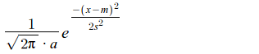
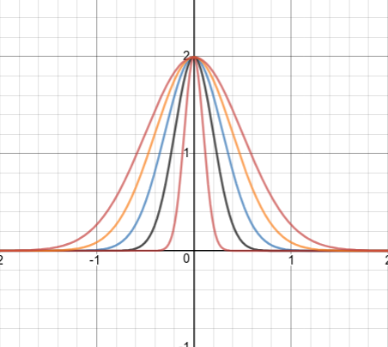
Motivation behind OUR Methodology
Motivation for taking angle distribution over the four qudrants using gaussian function :
This is done to ensure perceptually similar
angles of movement or orientations
have negligible differences,
which are glaringly distinct,
if discrete values are used,
quantified using the
circular nature of angle measurement

Slide 9
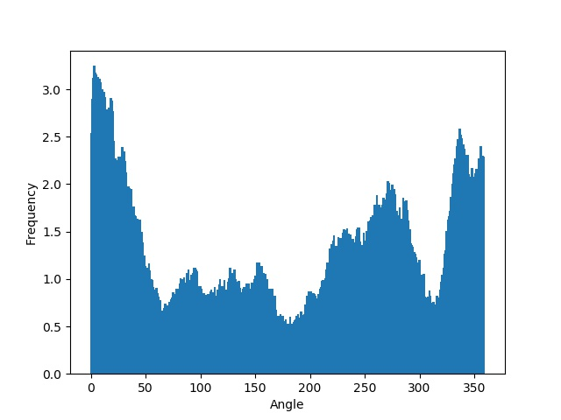
Frame Level Histogram for a structured video

Slide 10
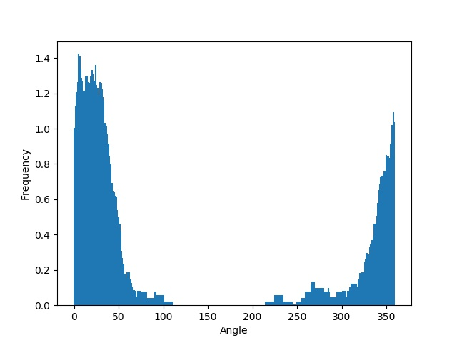
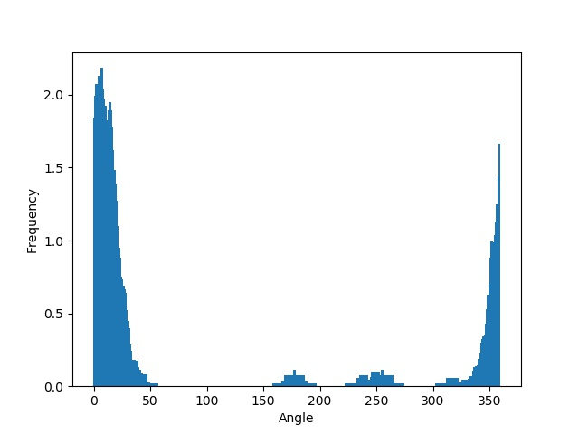
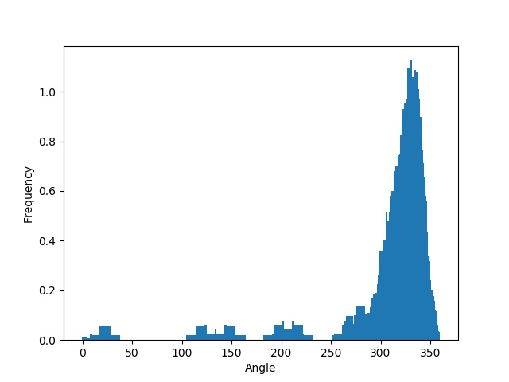
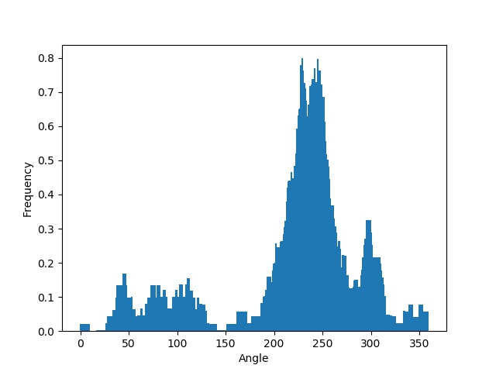
Block Level Histogram features for structured video

Slide 11
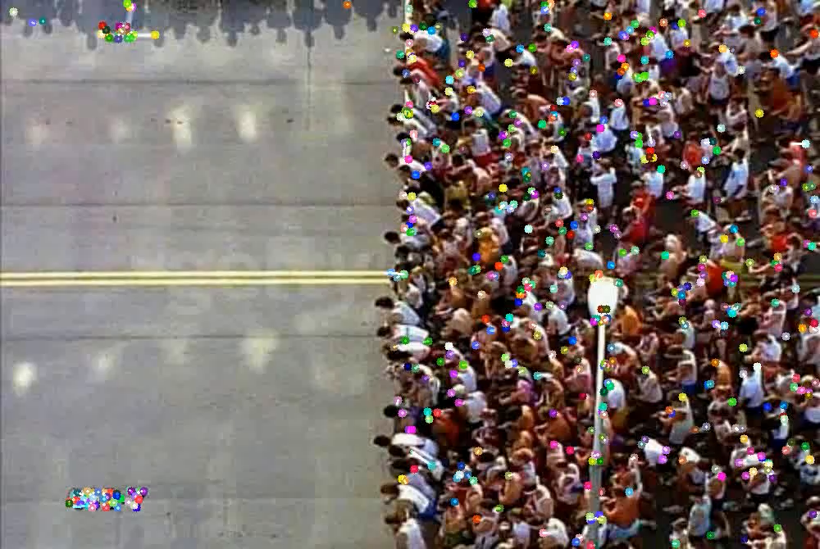
Structured Video Example I

Slide 12
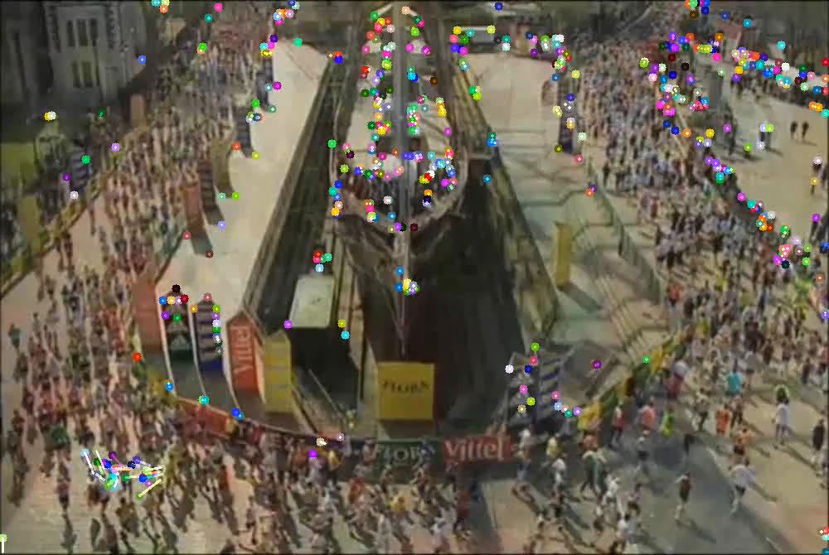
Structured Video Example II

Slide 13
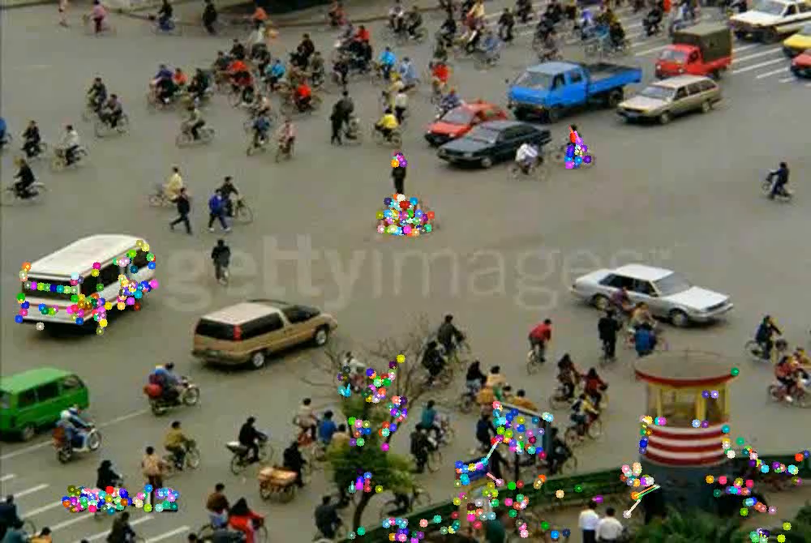
Semi Structured VIDEO EXAMPLE

Slide 14
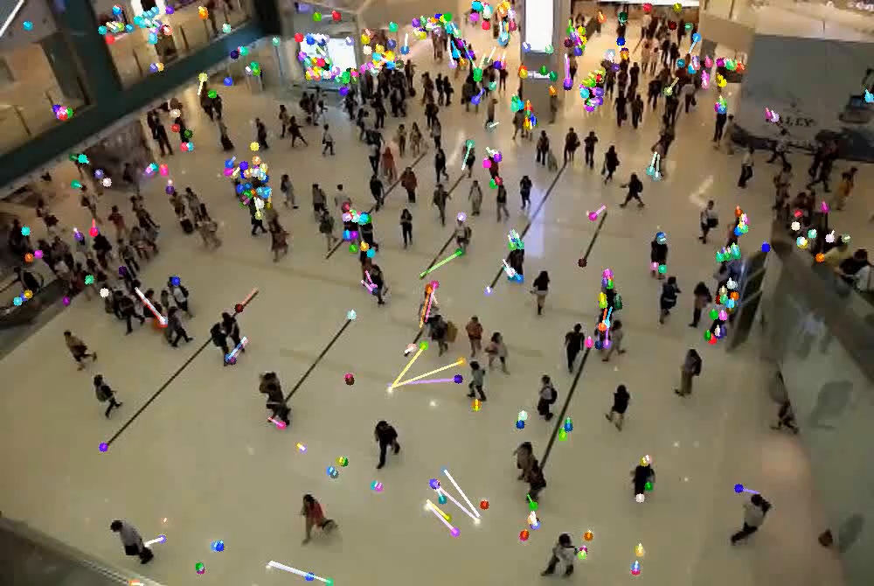
UNSTRUCTURED VIDEO EXAMPLE

Slide 15
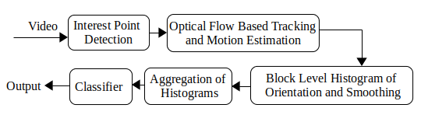
Overview of SOLUTION ARCHITECTURE

Slide 16
Tools used for our work
The whole coding is done in python using scikit-learn, scipy and numpy libraries for feature calculation.
For feature extraction we have used opencv library using python wrapper.
For classification we have used keras and scikit-learn libraries.
All the graph and histogram outputs are obtained using the matplotlib libraries in python.

Slide 17
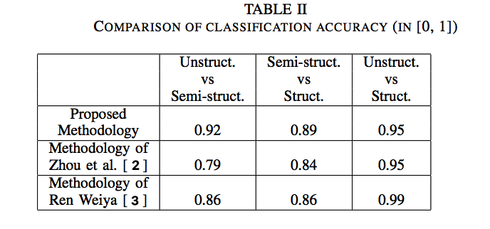
Results and analysis
We use the Collectiveness dataset for evaluating the performance of our model. The dataset has human evaluated labellings according to the flow structure in crowd motion.
There are three classes, un-structured, semi-structured and structured. We take two classes at a time, just like the original paper by Zhao et al.
We performed Stratified 10 fold Cross Validation to obtain better or comparable results in all cases.
In the other two occasions, we outperformed the original paper with a large margin.
Notes:
Demo Slide
<number>

Slide 18
References
T. Li, H. Chang, M. Wang, B. Ni, R. Hong, and S. Yan, “Crowded scene analysis: A survey,” IEEE transactions on circuits and systems for video technology, vol. 25, no. 3, pp. 367–386, 2015.
B. Zhou, X. Tang, and X. Wang, “Measuring crowd collectiveness,” in Computer Vision and Pattern Recognition (CVPR), 2013 IEEE Conference on. IEEE, 2013, pp. 3049–3056.
W. Ren, “Crowd collectiveness measure via graph-based node clique learning,” arXiv preprint arXiv:1612.06170, 2016.
X. Li, M. Chen, and Q. Wang, “Measuring collectiveness via refined topological similarity,” ACM Transactions on Multimedia Computing, Communications, and Applications (TOMM), vol. 12, no. 2, p. 34, 2016.
J. Shi and C. Tomasi, “Good features to track,” Cornell University, Tech. Rep., 1993.
B. D. Lucas, T. Kanade et al., “An iterative image registration technique with an application to stereo vision,” 1981.
Notes:
Dataset Description, Demo Videos and References
<number>

Slide 19
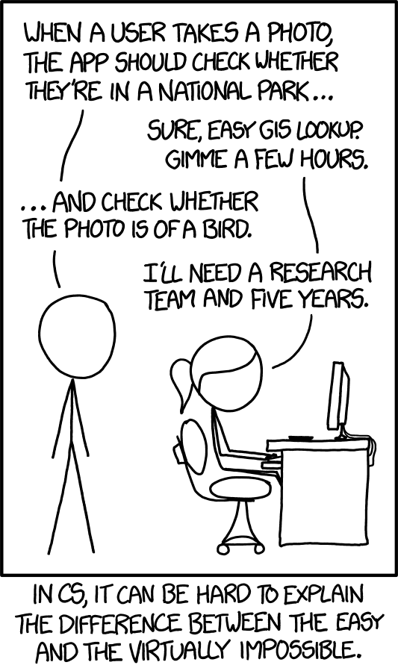
Questions

